Slide 1

Movie Sales Analysis
- PRESENTED BY -
1. Bhavik Mahajan
2. Mohit Chaudhari
3. Vaishnavi Surwase

Slide 2

INDEX
Business Objective
Approach To Prove Business Objective
Data Preparation
Key Visuals
Dashboard
Link To The Dashboard
Conclusion

Slide 3
🎯 Business Objective:
The main objective of this project is to study how different factors affect the success of movies released between 2006 and 2016. Using data from IMDb, the project focuses on understanding the connection between a movie’s revenue, rating, runtime, and genre.
The goal is to find out which types of movies perform best at the box office, how ratings influence revenue, and how movie performance has changed over the years. By analyzing these patterns, this project helps to understand what makes a movie successful and what kind of content audiences enjoy the most.
In simple terms, this project aims to give clear insights that can help movie producers, investors, and marketers make smarter decisions about movie production, budgeting, and marketing strategies in the future.

Slide 4
🎬 Approach to Prove the Business Objective:
Identify revenue patterns across different movie genres and years.
Analyze relationships between movie revenue, IMDb ratings, meta score, and runtime.
Compare performance of genres to find which types of movies perform best.
Measure impact of audience ratings and runtime on overall revenue trends.
Provide insights and recommendations to help producers and investors plan profitable movie projects.

Slide 5
🧹 Data Preparation Steps:
Data Collection: Collected IMDb dataset for movies.
Data Loading: Imported the dataset into Power BI for cleaning and analysis.
Data Cleaning: Removed missing values, duplicates, and irrelevant columns.
Data Formatting: Standardized data types (numbers, dates, and text) for accurate analysis.
Data Transformation: Created new calculated columns and measures like Total Revenue, Average Rating, and Average Runtime.
Data Validation: Verified data accuracy by checking values and summaries before visualization.

Slide 6
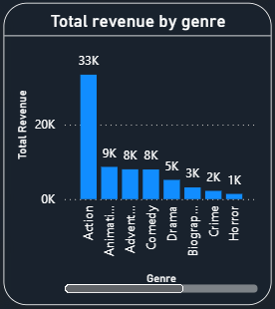
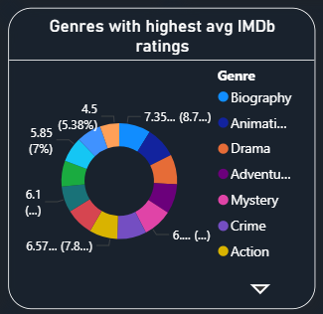
🎬 KEY VISUALS:
The chart shows that Action movies generated the highest total revenue (34K million), followed by Animation and Adventure.
This indicates that action-based genres dominate box office collections.
Genres like Biography, Crime, and Horror have lower revenue, suggesting smaller audiences or niche appeal.
The visual highlights Animation and Biography genres with the highest average IMDb ratings.
This shows that audience appreciation is often higher for story-driven and emotional genres.
The chart helps in understanding viewer preferences and quality perception across genres.

Slide 7
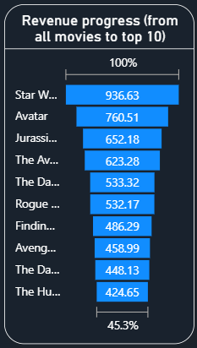
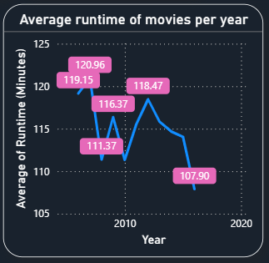
🎬 KEY VISUALS:
The chart shows the top 10 highest-grossing movies by total revenue.
Star Wars, Avatar, and Jurassic World lead the list with massive earnings.
These movies together contribute to a large share of total box office revenue.
Highlights how a few blockbuster films drive major industry profits.
Displays the average movie length trend from 2006 to 2016.
Runtime slightly fluctuates over the years, staying mostly between 110–120 minutes.
Suggests that movie duration has remained consistent, aligning with audience comfort levels.

Slide 8
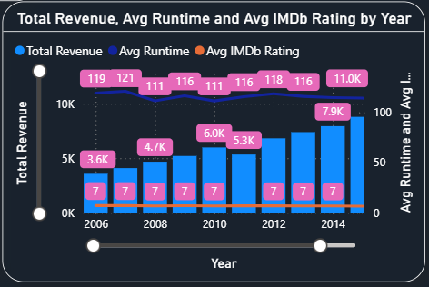
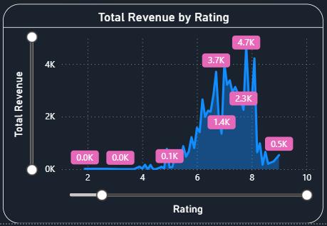
🎬 KEY VISUALS:
Combines three key factors — revenue, average runtime, and rating — by year.
Reveals that revenue gradually increased after 2010 while ratings remained fairly steady.
Helps identify industry growth and consistency in movie performance over the years.
The chart shows a clear positive relationship between IMDb ratings and revenue.
Movies rated between 7 and 8 earned the most revenue, showing audience trust in quality films.
Indicates that higher-rated movies generally perform better financially.

Slide 9
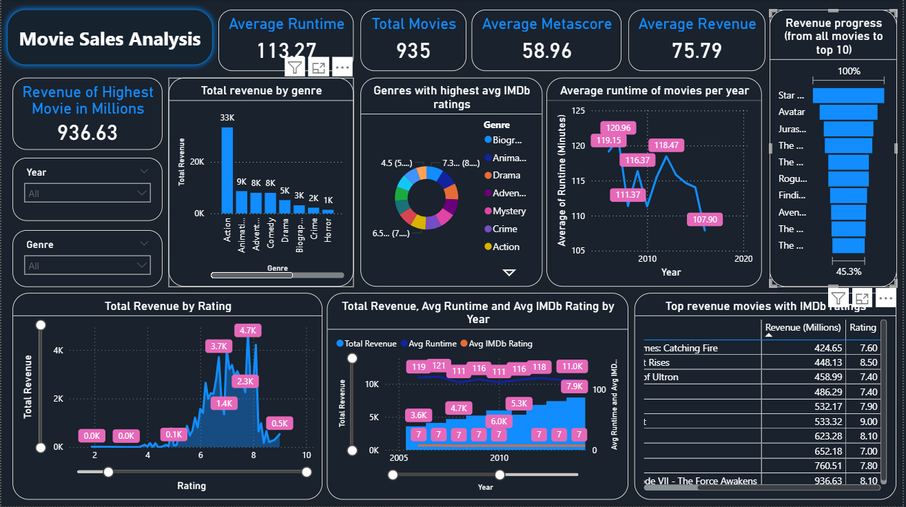
DASHBOARD:

Slide 10
LINK TO THE DASHBOARD:

Slide 11
🎯 Conclusion:
The analysis shows that Action, Animation, and Adventure movies generate the highest revenues.
Movies with higher IMDb ratings (7–8) generally earn more, proving the link between quality and success.
Star Wars, Avatar, and Jurassic World stand out as the top revenue-generating films.
The average movie runtime remains stable over the years, showing consistent audience preferences.
Overall, the study helps understand what factors drive movie success and can guide producers and investors in making smarter decisions for future films.

Slide 12
THANK YOU

